Slide 1


DEVELOPMENT OF INTEGRATED WEARABLE DEVICE FOR REMOTE MONITORING OF PREGNANT WOMEN IN GHANA
Project Supervisor
Dr. Godfrey Mills
Co-Supervisor
Prof. Elsie Effah Kaufmann
Group Members
Owoh Einsteina Ofunne - 10943874
Anane George Nyarko – 10947340
Adika Nathaniel - 10957036
DATE: 2nd May 2025
UNIVERSITY OF GHANA

Slide 2

COLLABORATORS
Nathaniel Sakyi Adibuer, IT Consortium
Dr. Frank Amegah, Korle-Bu Teaching Hospital

Slide 3
TASK DELEGATION
Owoh Einsteina Ofunne - AI Model Development
George Anane Nyarko - Mobile App Development
Adika Nathaniel - Wearable Device Development

Slide 4
AI MODEL PROGRESS
KEY OBJECTIVES
Train separate models for detecting preeclampsia, and gestational diabetes.
Use real-world medical datasets to analyze health indicators.
Implement a structured machine learning pipeline from preprocessing to evaluation.
Compare different models to find the best-performing approach for each condition.

Slide 5
DATASET OVERVIEW
PREECLAMPSIA
Dataset Name: preeclampsia_dataset.csv
Source: Manually generated
Number of Samples: 10,000
Number of Input Features: 4
Output States: Low, mild or High
Description: Dataset of 10,000 records generated to predict preeclampsia risk (Low, Mild, High) based on diastolic pressure, systolic pressure, temperature and urine protein levels, with added noise to simulate real-world variability.

Slide 6
FEATURES
PREECLAMPSIA
Systolic blood pressure
Diastolic blood pressure
Protein in urine
Body temperature

Slide 7
THRESHOLD DESCRIPTION
PREECLAMPSIA
SOURCES:
ACOG Practice Bulletin No. 222: Gestational Hypertension and Preeclampsia
NICE_guidance_on-Pre-eclampsia_VB2020
UpToDate: Clinical features and diagnosis of preeclampsia
WHO Guidelines: WHO Recommendations for Prevention and Treatment of Preeclampsia and Eclampsia

Slide 8
DATASET OVERVIEW
GESTATIONAL DIABETES
Dataset Name: Gestational Diabetes 3.csv
Source: Manually generated
Number of Samples: 10,000
Number of Input Features: 4
Output States: Low, mild or high
Description:

Slide 9
FEATURES
GESTATIONAL DIABETES
Blood Glucose level
BMI
Family history
Body Temperature

Slide 10
DATASET OVERVIEW
ANEMIA

Slide 11
MODEL SELECTION
PREECLAMPSIA
We chose the best performing model which was Logistic Regression. Although Decision Tree and Random Forest performed slightly better overall, they tend to overfit, whereas Logistic Regression generalizes well to unseen data.
Performance Metrics | Logistic Regression | K-Nearest Neighbour | Support Vector Machine | Decision Tree Classifier | Random Forest Classifier | Gradient Boosting Classifier | MLP Classifier
Precision | 0.9646 | 0.9611 | 0.9691 | 0.9425 | 0.9625 | 0.9645 | 0.969644
F1 Score | 0.9645 | 0.9610 | 0.9690 | 0.9425 | 0.9624 | 0.9645 | 0.969549
Recall | 0.9645 | 0.9610 | 0.9690 | 0.9425 | 0.9635 | 0.9645 | 0.969503
Training Accuracy | 0.9637 | 0.9694 | 0.9658 | 1.0000 | 0.9998 | 0.9809 | 0.965494
Test Accuracy | 0.9710 | 0.9635 | 0.9700 | 0.9415 | 0.9630 | 0.9645 | 0.9700
Validation Accuracy | 0.9645 | 0.9610 | 0.9690 | 0.9425 | 0.9625 | 0.9645 | 0.9695

Slide 12
TIME TAKEN (S)
PREECLAMPSIA
Performance Metrics | Logistic Regression | K-Nearest Neighbour | Support Vector Machine | Decision Tree Classifier | Random Forest Classifier | Gradient Boosting Classifier | MLP Classifier
Training Time | 0.1112 | 0.0179 | 0.3972 | 0.0549 | 2.3782 | 9.0418 | 5.0945
Prediction Time | 0.0005 | 0.3580 | 0.3481 | 0.0010 | 0.0379 | 0.0169 | 0.0047

Slide 13
K - FOLD CROSS VALIDATION
PREECLAMPSIA
Fold | Accuracy | Precision | Recall | F1-Score
1 | 0.970833 | 0.970777 | 0.970833 | 0.970774
2 | 0.960833 | 0.961512 | 0.960833 | 0.961008
3 | 0.966667 | 0.966666 | 0.966667 | 0.966657
4 | 0.958333 | 0.958416 | 0.958333 | 0.958367
5 | 0.958299 | 0.958337 | 0.958283 | 0.958306

Slide 14
BRIEF DESCRIPTION OF MODELS
LOGISTIC REGRESSION
Logistic regression is a statistical model used for binary classification tasks, where the output is a categorical variable with two possible outcomes. The model uses a sigmoid function to map predicted values to probabilities.

Slide 15
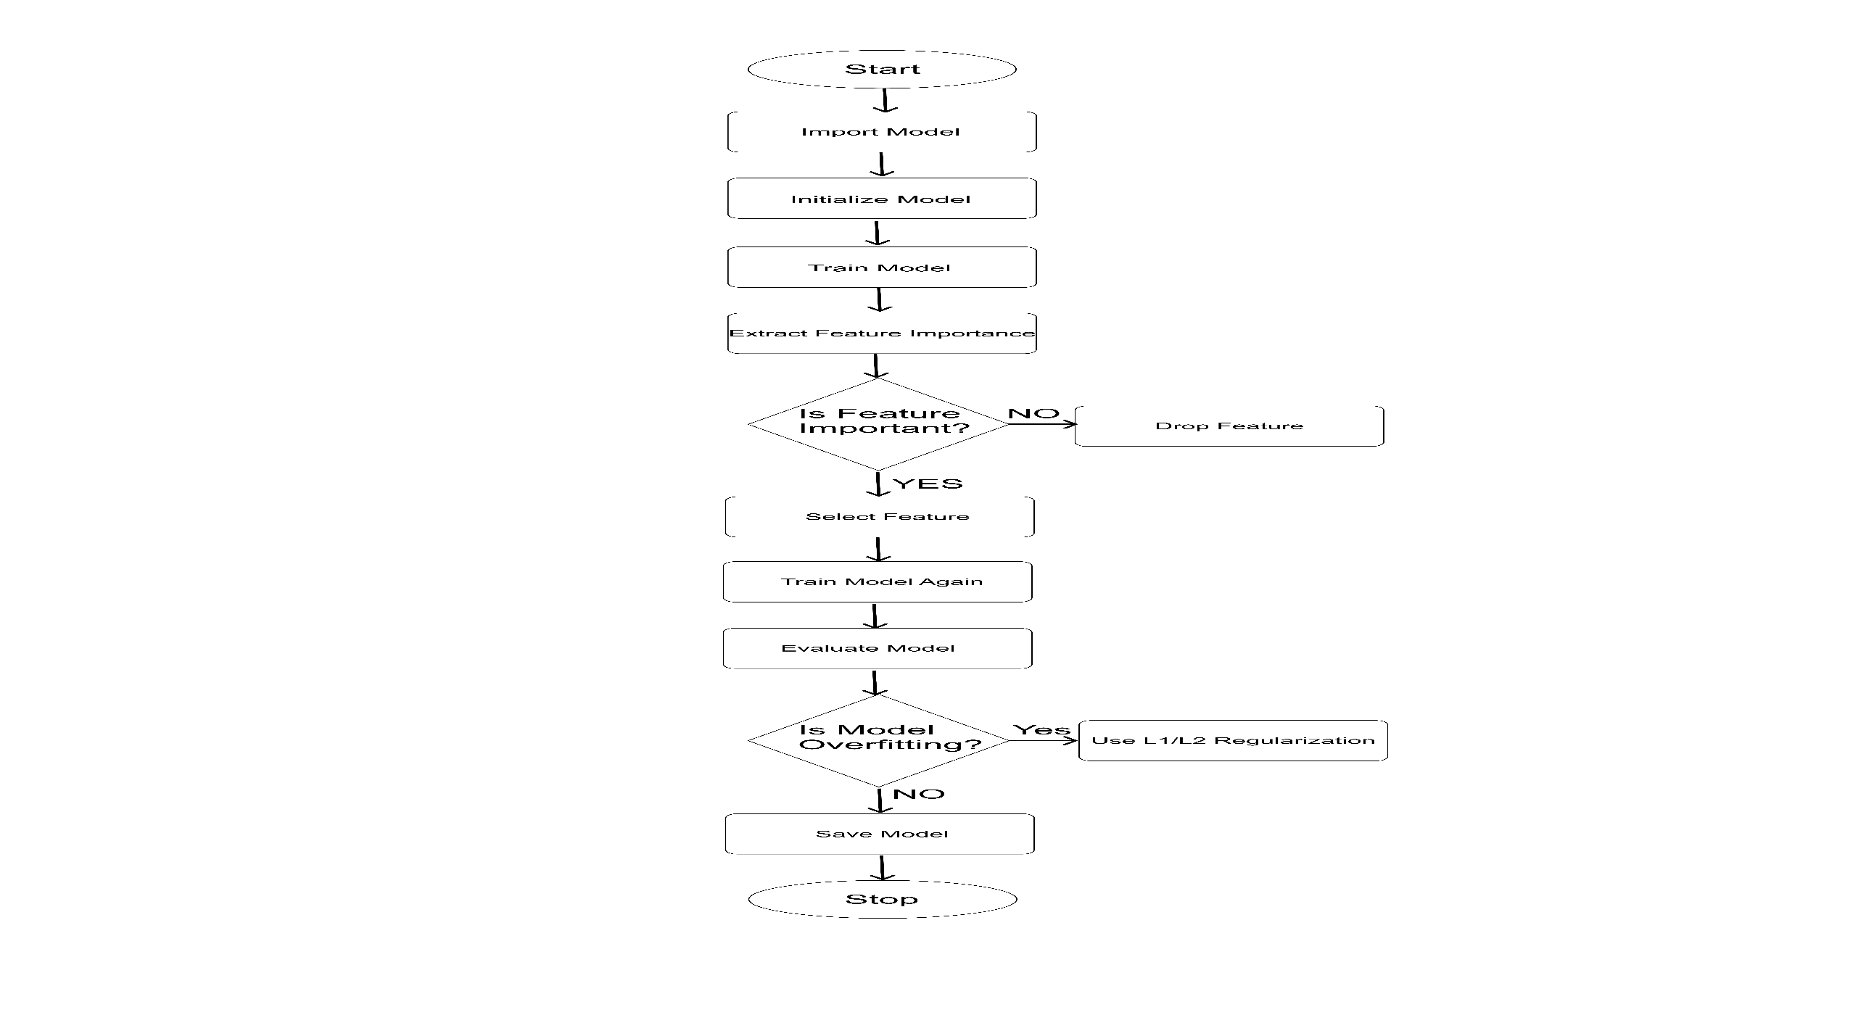
MACHINE LEARNING WORKFLOW

Slide 16
MOBILE APP PROGRESS
Setting up backend functionality for SMS Notifications for:
Medication Reminders
Antenatal Visit Reminder
Daily Pregnancy Tips Based on Subsription or Not

Slide 17
BODY TEMPERATURE MEASUREMENT
^{(A) TMP117 Temperature Sensor}
(B) MAX30205 Temperature Sensor
^{(C) ADT7420 Temperature Sensor}

Slide 18
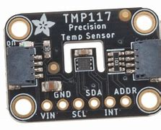
^{TMP117 Temperature Sensor}
Voltage Range: 1.7 V to 5.5 V
Power Consumption:
• Active: 3.5 μA (typical)
• Shutdown: 150 nA
Conversion Rate: 1 Hz (1 reading/second)
Operating Temp Range: –55 °C to 150 °C

Slide 19
^{TMP117 Temperature Sensor}
Accuracy:
• ±0.1 °C (–20 °C to 50 °C)
• ±0.3 °C (–55 °C to 150 °C)
Resolution: 16-bit → 0.0078 °C/LSB
Thermal Response Time: ~0.39 to 0.72 s
Communication Protocol: I²C

Slide 20
^{TMP117 Temperature Sensor}
Size:
• WSON: 2.00 mm × 2.00 mm
• DSBGA: 1.53 mm × 1.00 mm
Applications: Wearables, industrial sensing, medical devices
Cost Range: $2.15 – $7.68 USD
• $2.15 → TMP117MAIDRVR
• $7.68 → TMP117AIDRVT Digi-Reel

Slide 21
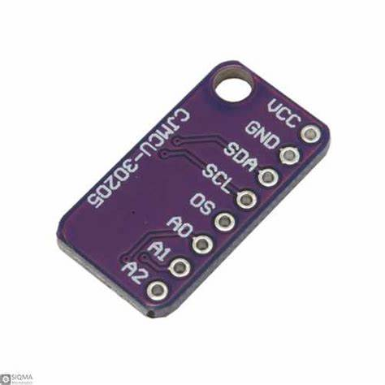
^{MAX30205 Temperature Sensor}
Temperature Range: 0 °C to +50 °C
Accuracy: ±0.1 °C (medical-grade)
Supply Voltage: 2.7 V to 3.3 V
Communication Protocol: I²C

Slide 22
^{MAX30205 Temperature Sensor}
Power Consumption:
• Active: 600 µA (typical)
• Shutdown: 0.1 µA
Response Time: Fast (real-time optimized)
Applications: Wearables, health monitors, medical devices
Cost: $11.69 USD
Dimensions: 4.9 mm × 3.9 mm

Slide 23
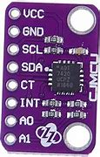
^{ADT7420 Temperature Sensor}
Temperature Range: –40 °C to +150 °C
Accuracy: ±0.1 °C (medical-grade)
Supply Voltage: 2.7 V to 5.5 V
Communication Protocols: I²C or SPI
Power Consumption:
• Active: 210 µA
• Shutdown: 2 µA
Package Size: 16-lead LFCSP (3 mm × 3 mm)
Applications: Wearables, industrial equipment, healthcare devices
Cost: $9.87 USD

Slide 24
KEY ADVANTAGES OF TMP117 SENSOR
Ultra-low power consumption : extends battery life in wearables
Tiny size : Fits in compact designs like smart patches
Medical-grade accuracy : ±0.1°C in body temperature range
Cost-effective

Slide 25
Heart Rate and Oxygen Saturation Sensor
MAX30102 Sensor
SparkFun Pulse Oximeter (MAX32664C Integrated)
MAX30112 Sensor

Slide 26
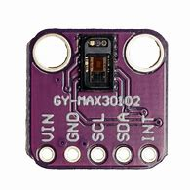
MAX30102 Sensor
Functionality: Measures Heart Rate (PPG) and SpO₂
Communication Protocol: I²C
Supply Voltage: VDD = 1.8V; LED Driver = 3.3V–5.5V
Operating Temp Range: –40°C to +85°C
Power Consumption:
• Active: 1.6 mA
• Shutdown: 0.7 µA
Size: 5.6 mm × 3.3 mm × 1.55 mm
Continuous Power Dissipation: 440 mW @ 70°C
Communication : Supports I²C protocol
Cost: $12.99 USD

Slide 27
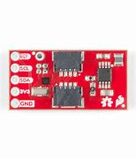
SparkFun Pulse Oximeter
Functionality: Measures Heart Rate and SpO₂
Power Consumption: ~0.7 mA (operating)
Communication Protocol: I²C
Supply Voltage: 1.8V to 3.3V
Size: 12.7 mm × 10.2 mm
Pre-calibrated sensor (saves setup time)
Optimized for ESP32 and prototyping
Cost: $52.52 USD

Slide 28
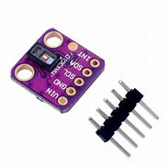
MAX30112 Sensor
Supply Voltage:
• Core: 1.8V
• LED: 3.1V to 5.25V
Operating Temp Range: –40°C to +85°C
Shutdown Current: 1.4 µA
Communication Protocol: I²C
Size: 2.8 mm × 2.0 mm
Package: 6×4 ball WLP (0.4 mm pitch)
Continuous Power Dissipation: 440 mW @ 70°C
Cost: $6.80 USD

Slide 29
KEY ADVANTAGES OF MAX30102
Compact Size – Ideal for Space Constraints
At just 5.6 mm × 3.3 mm × 1.55 mm, the MAX30102 is small enough to fit into slim and stylish smartwatch designs without compromising aesthetics or comfort.
Low Power Consumption – Crucial for Battery Life
Active: 1.6 mA (typical)
Shutdown: 0.7 µA

Slide 30
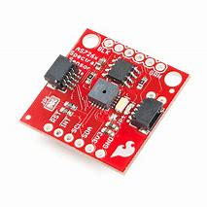
BLOOD PRESSURE AND BLOOD GLUCOSE MEASUREMENT
AS7263 Near Infrared (NIR) Spectral Sensor
Functionality: Measures near-infrared reflectance for spectroscopy
Detected Wavelengths: 610, 680, 730, 760, 810, 860 nm (±10 nm bandwidth)
ADC: 16-bit digital output
Operating Voltage: 2.7V to 3.6V
Built-in NIR LED for illumination
External LED pins for custom lighting
2x Qwiic connectors for I²C integration
Power Supply: Qwiic-enabled (1 mm pitch 4-pin JST)
Communication Interfaces: I²C (Addr: 0x49) & UART

Slide 31
BLOOD PRESSURE AND BLOOD GLUCOSE MEASUREMENT
Applications:
• Material classification
• Biomedical monitoring
• Wearable NIR sensing
• Agricultural analysis
Cost: $33.59 USD

Slide 32
Why I²C Communication ?
Compact Design = Fewer Wires = Smaller Wearable
Ultra-Low Power = Longer Battery Life
Multi-Sensor Support on One Bus
Code Efficiency with ESP32 Libraries
Scalable and Ready for Expansion

Slide 33
MICROCONTROLLERS FOR WEARABLE DEVICE
ESP32-S3-WROOM-1/1U/2
SiFli SF32LB5J
STM32F217

Slide 34
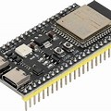
MICROCONTROLLERS FOR WEARABLE DEVICE
Microcontroller: ESP32-S3-WROOM-1/1U/2
CPU: Dual-core 32-bit Xtensa® LX7, up to 240 MHz
Wireless Connectivity: Wi-Fi 802.11 b/g/n (2.4 GHz), Bluetooth® 5 (LE)
Memory: 8 MB Flash, up to 8 MB PSRAM (variant-dependent)
GPIO: 22 digital I/O pins
Analog Inputs: 6 ADC channels
PWM Outputs: 6 channels
Interfaces Supported: I²C, SPI, UART, USB OTG, ADC, DAC

Slide 35
MICROCONTROLLERS FOR WEARABLE DEVICE
Operating Voltage: 3.3 V
Power Supply: 5 V input via USB Type-C or 5V pin
Onboard Regulator: 5 V to 3.3 V Low Dropout (LDO)
Current Supply: Up to 800 mA from the 3.3 V rail
LDO Regulator: Converts 5 V to stable 3.3 V output
Safe Power Delivery: Powers microcontroller and sensors safely
Power Flexibility: Accepts USB or Li-Ion battery modules
Ideal for Wearables: Efficient and compact for mobile power sources

Slide 36
SiFli SF32LB5J MCU
High-Performance Core: Arm Cortex-M33 @ 240 MHz (370 DMIPS, 984 CoreMark)
Low-Power Core: Arm Cortex-M33 @ 24 MHz (64 KB SRAM)
Total SRAM: 512 KB (HCPU) + 64 KB (LCPU)
Dual-core architecture for performance & efficiency
NOR Flash (SiP): up to 96 MHz
OPI-PSRAM (SiP): up to 144 MHz
External Memory Support: NOR, NAND, OPI-PSRAM via QSPI
SD/SDIO/eMMC Support: SD3.0, SDIO3.0, eMMC

Slide 37
SiFli SF32LB5J MCU
GPU: ePicaso 2.0 for 2D/2.5D rendering
Max Resolution: 512×512
Display Interfaces: 8080, SPI, Dual-/Quad-SPI
LCD Support: 1 layer + background with alpha blending
Bluetooth 5.3 Dual Mode with BLE Audio
Sensitivity: –100 dBm (BLE 1 Mbps)
Tx Power: Up to 19 dBm
Low Power BLE Mode: ~50 µA connected

Slide 38
SiFli SF32LB5J MCU
GPIOs: Up to 45
Serial Interfaces: 3× UART, 4× I²C, 2× SPI
12-bit ADC (8 channels) + Integrated Temp Sensor
DMA: Internal + extDMA (external memory)
Timers: GPTIM, BTIM, ATIM, LPTIM, WDT, RTC
Supports advanced timing and system scheduling
Security: AES, HASH, CRC, TRNG, PSA Level 1
Battery Charging: 560 mA lithium charger (4.2–4.45 V)

Slide 39
SiFli SF32LB5J MCU
Low Power: 2 µA sleep current
Power Input: VBAT 3.2–4.7V, VBUS 4.6–5.5V
Dimensions: 7 × 7 × 0.85 mm
Total GPIOs: 44
Supports 4 I²C interfaces for flexible sensor integration

Slide 40
STM32F217 MCU
CPU Core: Arm Cortex-M3 32-bit RISC @ up to 120 MHz
Performance: 150 DMIPS / 398 CoreMark from Flash with ART Accelerator™
Embedded Flash Memory: 256 KB to 1 MB
SRAM: Up to 128 KB + Boot ROM with ISP support
90 nm CMOS process with dynamic voltage scaling
Power consumption: 175 µA/MHz at 120 MHz from Flash
Power Modes: Sleep, Stop, Standby with fast wake-up
Optimized for performance and low power

Slide 41
STM32F217 MCU
6× USART, 3× SPI, 3× I²C, 2× CAN 2.0B, 1× SDIO
Up to 17 timers: general-purpose, advanced, watchdog
Timer support for 16-/32-bit and time-critical tasks
STM32F217 only: Crypto/Hash engine (AES, 3DES, MD5, SHA-1)
FSMC: Supports SRAM, PSRAM, NOR/NAND Flash, CompactFlash
Dual-bank Flash operation (read-while-write)
Boot Modes: Flash, system memory, or SRAM
TCSRAM: Fast access, tightly coupled SRAM

Slide 42
TINY ML MCU
1)STM32H723ZG
2) ESP32-S3-DevKitC-1
3)ESP32-C3

Slide 43
STM32H723ZG MCU
Processor: 32-bit RISC-V single-core @ 160 MHz
Memory: 400 KB SRAM + 4 MB Flash
Wireless: Wi-Fi (802.11 b/g/n) & Bluetooth 5 (BLE)
Form Factor: Ultra-small (21 × 17.8 mm), single-sided components
Power Supply: 3.7 V lithium battery with onboard charging
GPIO: 11 digital I/O pins with PWM support
Analog Inputs: 4 ADC pins
Deep Sleep Power Consumption: ~43 μA

Slide 44
STM32H723ZG MCU
Ethernet MAC: 10/100 Mbps with IEEE 802.3
USB: 1× OTG Full-/High-Speed
CAN: 3× Flexible Data-rate (FD-CAN)
GPIOs: Up to 114 with external interrupt support
UART/USART: Up to 4×
SPI: Up to 6×
I²C: Up to 4×
I²S, SAI, SPDIF_RX, HDMI-CEC,

Slide 45
STM32H723ZG MCU
Security: TRNG, MPU, ECC for memory protection
Power Supply Range: 1.62 V to 3.6 V
Power Modes: Sleep, Stop, Standby
Backup Domain: VBAT for RTC & backup registers

Slide 46
ESP32-S3-DevKitC-1 MCU
Processor: Dual-core Xtensa® 32-bit LX7, up to 240 MHz
AI/Signal Acceleration: Vector instructions for neural networks & DSP
Internal Memory: 512 KB TCM SRAM, 384 KB ROM
Cache: 256 KB embedded instruction/data cache
External Flash: Up to 32 MB (Quad/Octal SPI)
External PSRAM: Up to 8 MB (Quad/Octal SPI)
Instruction/Data Cache Support
Designed for high-performance memory access

Slide 47
ESP32-S3-DevKitC-1 MCU
Wi-Fi: 802.11 b/g/n (2.4 GHz), up to 150 Mbps
Bluetooth 5 (LE): Long Range, Advertising Extensions, 2 Mbps PHY
USB 1.1 OTG with PHY (native, full-speed)
Ideal for IoT & wireless applications
Encryption: AES-128/256, SHA-2, RSA, HMAC, Digital Signature
GPIOs: Up to 45 configurable GPIOs
ADC/DAC: 2× 12-bit SAR ADC (20 channels), 2× 8-bit DAC

Slide 48
ESP32-S3-DevKitC-1 MCU
Operating Voltage: 1.8V or 3.3V
Low Power Modes: Deep Sleep (~10 µA), Light Sleep
Module Options: PCB or u.FL antenna, up to 32 MB Flash
Operating Temp Range: –40 °C to +105 °C with ±2 kV ESD protection

Slide 49
ESP32-C3 MCU
Processor: 32-bit RISC-V single-core @ 160 MHz
Memory: 400 KB SRAM + 4 MB Flash
Wireless: Wi-Fi (802.11 b/g/n) & Bluetooth 5 (BLE)
Form Factor: Ultra-small (21 × 17.8 mm), single-sided component
Power Supply: 3.7 V lithium battery with onboard charging
GPIO: 11 digital I/O pins with PWM support
Analog Inputs: 4 ADC pins
Deep Sleep Power Consumption: ~43 μA

Slide 50
ESP32-C3 MCU
Interfaces: I²C, 2× UART, SPI
RF Performance: External RF antenna included
Buttons: Onboard Reset & Bootloader mode
Wake-Up Support: GPIO wake-up from deep sleep (D0–D3)
Security: AES-128/256, Hash, RSA, HMAC (hardware acceleration)

Slide 51
COMPONENT SELECTIONS
TMP117 Temperature Sensor - Body Temperature Measurement
MAX30102 Sensor - Heart Rate and Oxygen Saturation
AS7263 NIR Spectral Sensor - Blood Pressure and Blood Glucose
SF32LB52J - MCU for wearable Device
ESP32-S3-DevKitC-1 - MCU for tinyML

Slide 52
MISCELLANEOUS
QUESTIONS/FEEDBACK

